Slide 1
Algorithm Analysis and Design Divide and Conquer strategy (Heap Sort)
Lecture -18

Slide 2
Overview
• O(n lg n) worst case-like merge sort.
• Sorts in place-like insertion sort.
• Combines the best of both algorithms.

Slide 3
Heap data structure

Slide 4
Example

Slide 5
Heap property
For max-heaps (largest element at root), max-heap property: for all nodes i ,
excluding the root, A[PARENT(i )] ≥ A[i ].
For min-heaps (smallest element at root), min-heap property: for all nodes i ,
excluding the root, A[PARENT(i )] ≤ A[i ].

Slide 6
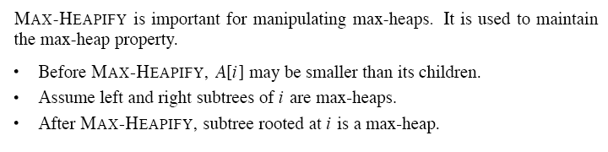
Maintaining the heap property

Slide 8
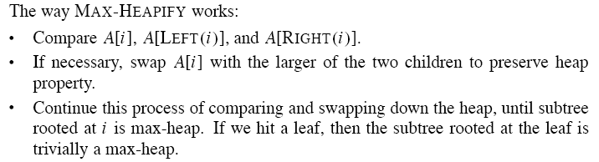

Slide 10
Building a heap

Slide 11
Example
Building a max-heap from the following unsorted array results in the
first heap example.

Slide 13
Correctness
Initialization:
Initialization:we know that each node . . . , n is a leaf, which is the root of a trivial max-heap. Since i = before the first iteration of the for loop, the invariant is initially true.
Maintenance: Children of node i are indexed higher than i , so by the loop invariant, they are both roots of max-heaps. Correctly assuming that i+1, i+2, . . . , n are all roots of max-heaps, MAX-HEAPIFY makes node i a max-heap root. Decrementing i re-establishes the loop invariant at each iteration.
Termination: When i = 0, the loop terminates. By the loop invariant, each node, notably node 1, is the root of a max-heap.

Slide 14
Analysis
• Simple bound: O(n) calls to MAX-HEAPIFY, each of which takes O(lg n) time ⇒ O(n lg n).
• Tighter analysis: Observation: Time to run MAX-HEAPIFY is linear in the height of the node it’ s run on, and most nodes have small heights. Have ≤ nodes of height h.

Slide 16
The heapsort algorithm
Given an input array, the heapsort algorithm acts as follows:
• Builds a max-heap from the array.
• Starting with the root (the maximum element), the algorithm places the maximum element into the correct place in the array by swapping it with the element in the last position in the array.
• “Discard” this last node (knowing that it is in its correct place) by decreasing the heap size, and calling MAX-HEAPIFY on the new (possibly incorrectly-placed) root.
• Repeat this “discarding” process until only one node (the smallest element) remains, and therefore is in the correct place in the array.

Slide 17
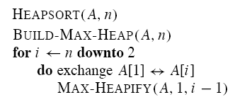

Slide 18
Example

Slide 19
Analysis
• BUILD-MAX-HEAP: O(n)
• for loop: n − 1 times
• exchange elements: O(1)
• MAX-HEAPIFY: O(lg n)
Total time: O(n lg n).

Slide 20
Heap implementation of priority queue
Heaps efficiently implement priority queues. These notes will deal with max priority queues implemented with max-heaps. Min-priority queues are implemented with min-heaps similarly.
A heap gives a good compromise between fast insertion but slow extraction and vice versa. Both operations take O(lg n) time.

Slide 21
Priority queue
Maintains a dynamic set S of elements.
• Each set element has a key-an associated value.
• Max-priority queue supports dynamic-set operations:
• INSERT(S, x): inserts element x into set S.
• MAXIMUM(S): returns element of S with largest key.
• EXTRACT-MAX(S): removes and returns element of S with largest key.
• INCREASE-KEY(S, x, k): increases value of element x’s key to k. Assume k ≥ x’s current key value.
• Example max-priority queue application: schedule jobs on shared computer.

Slide 22
• Min-priority queue supports similar operations:
• INSERT(S, x): inserts element x into set S.
• MINIMUM(S): returns element of S with smallest key.
• EXTRACT-MIN(S): removes and returns element of S with smallest key.
• DECREASE-KEY(S, x, k): decreases value of element x’s key to k. Assume k ≤ x’s current key value.
• Example min-priority queue application:
event - driven simulator.

Slide 23
Finding the maximum element
Getting the maximum element is easy: it’s the root.
HEAP-MAXIMUM(A)
return A[1]
Time: (1).

Slide 24
Extracting max element
Given the array A:
• Make sure heap is not empty.
• Make a copy of the maximum element (the root).
• Make the last node in the tree the new root.
• Re-heapify the heap, with one fewer node.
• Return the copy of the maximum element.
HEAP-EXTRACT-MAX(A, n)
if n < 1
then error .heap underflow.
max ← A[1]
A[1] ← A[n]
MAX-HEAPIFY(A, 1, n − 1) remakes heap
return max

Slide 25

Thank U

